Slide 1

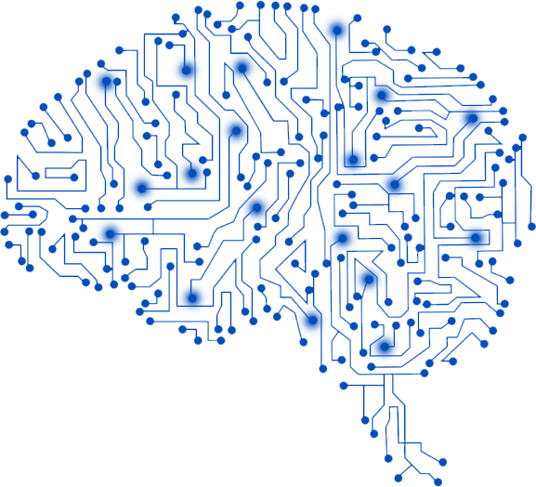
Deep Learning
By Hidayatullah ARGHANDABI

Slide 2
Contents
What is deep Learning
How deep Learning works
Deep learning vs machine learning
Real World Projects
Code our Deep learning based detection algorithm

Slide 3
Motivation
The exponentially-growth of the filed
Field is very young.
Building you own code library can bring work to home

Slide 4
Roadmap
Searched the literature
Companies involved in Deep learning
Real World examples
Share my own experience
Current available algorithms

Slide 5





Development environment & Hardware
NodeJS for the project (JavaScript)
Write test as we go along

Slide 6
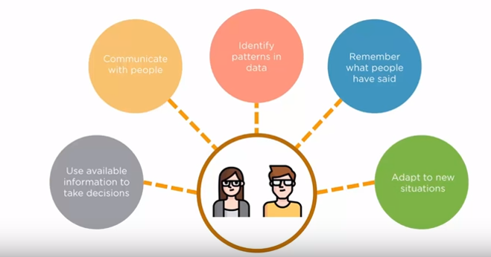

Slide 7
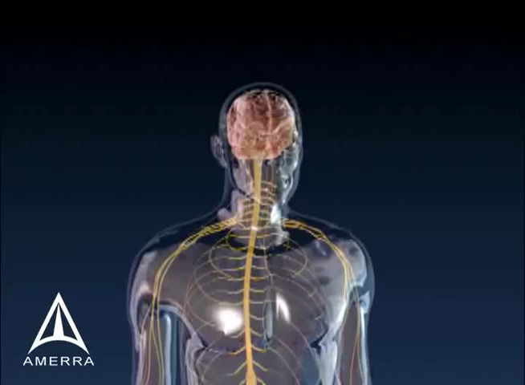

Slide 8
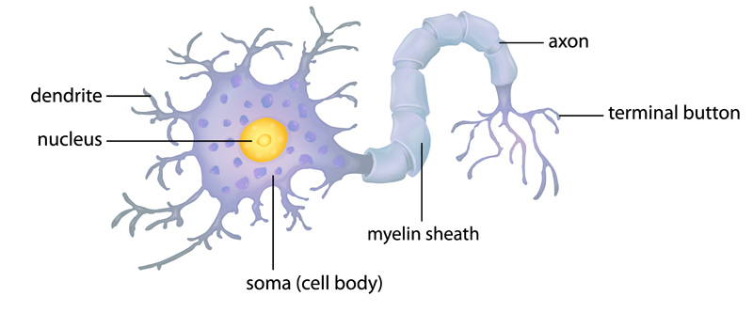

Slide 9
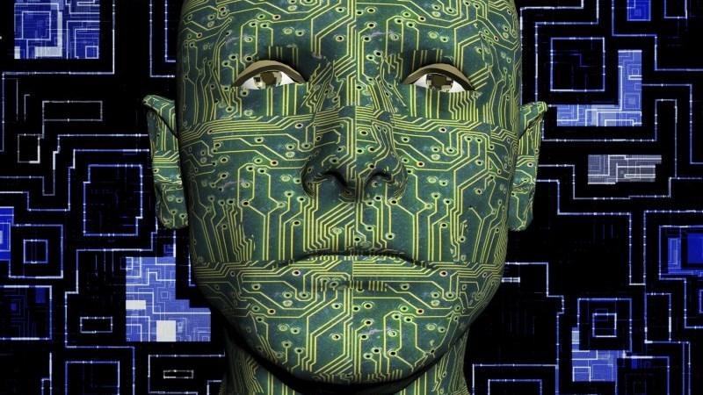
Detects Humans using neural networks

Slide 10
What is the deep Learning?
a type of machine learning in which a model learns to perform classification tasks directly from images, text, or sound.
Uses a neural network architecture
The term “deep” refers to the number of layers in the network
Invented in 1960-1970
Popular in 1980
Neuron networks will change the world
Suddenly Lost the popularity, Technology was not right standard to faciltate the neuron networks.

Slide 11
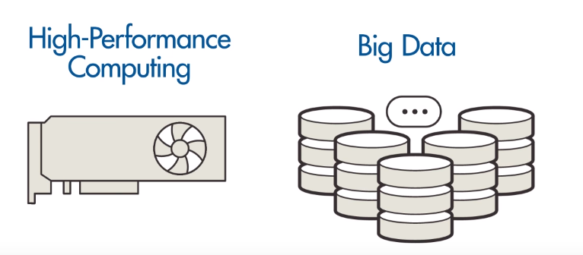
Need for Deep Learning and Neural Networks
Data (Lot of data)
Processing power, Strong computer to process that data.

Slide 12
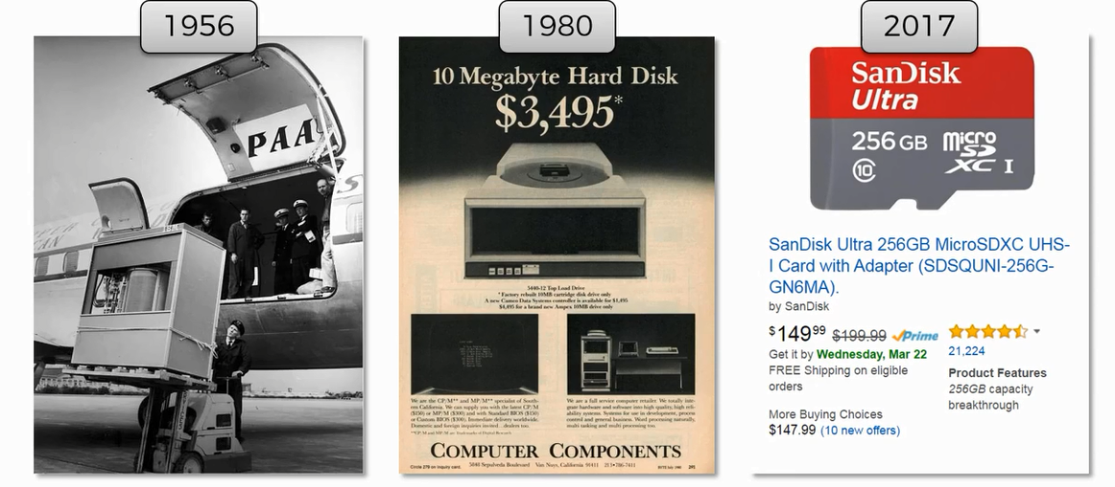

Slide 13
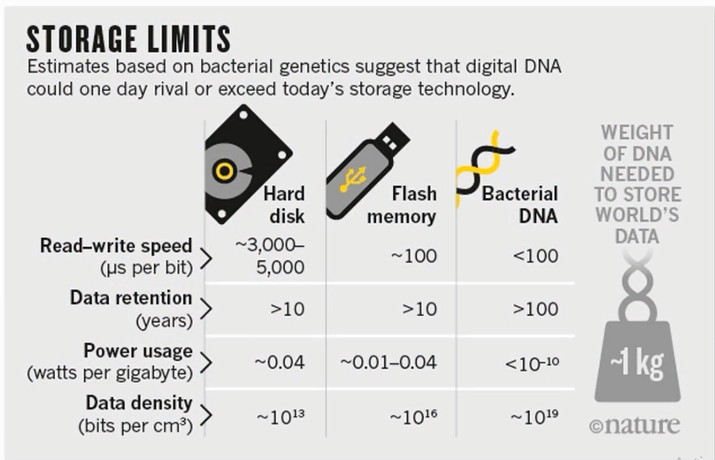

Slide 14
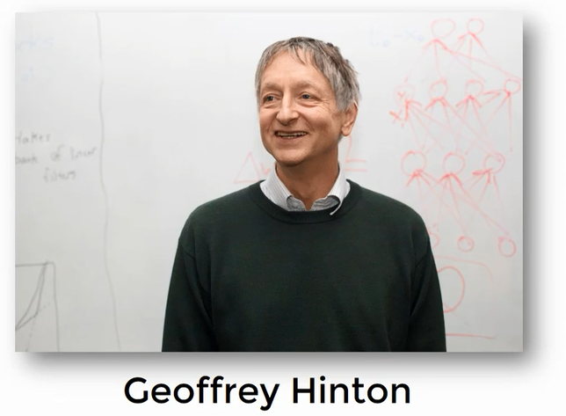

Slide 15
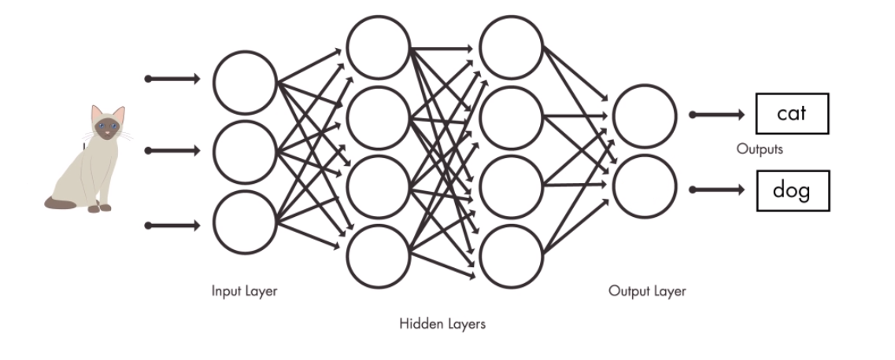
Neural Network

Slide 16
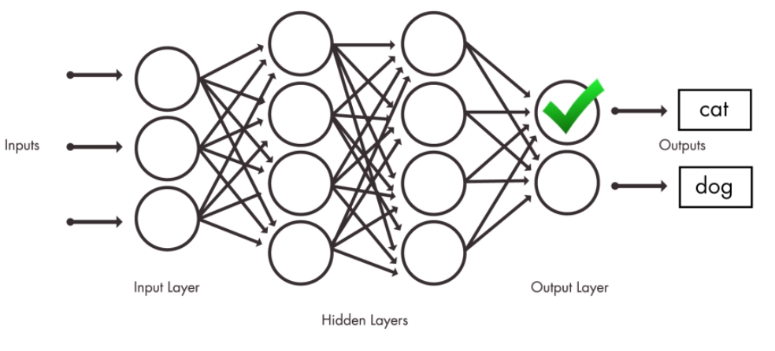
Neural Network
Notes:
So that your organization can tract its economical history. As a ledger the blockchain servers the purpose of storing the transaction. In fact it is a distributed ledger

Slide 17
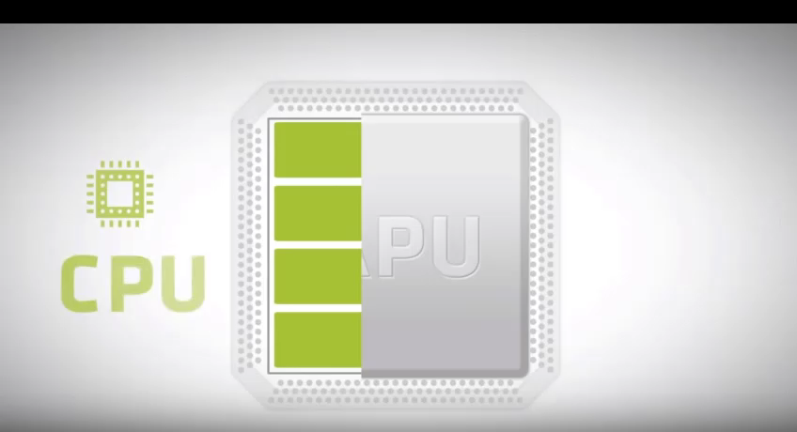
GPU Programming
Notes:
A cpu consists of a few cores,
GpU consists of massive parallel architecture. Consists of 1000 more small cores
GPUs can often achieve up to 100x speedup over similar CPU algorithms
Designed for handalling multiple tasks simultaneously.
In software instructions are executed after one other but there are software that need parallel support.

Slide 18
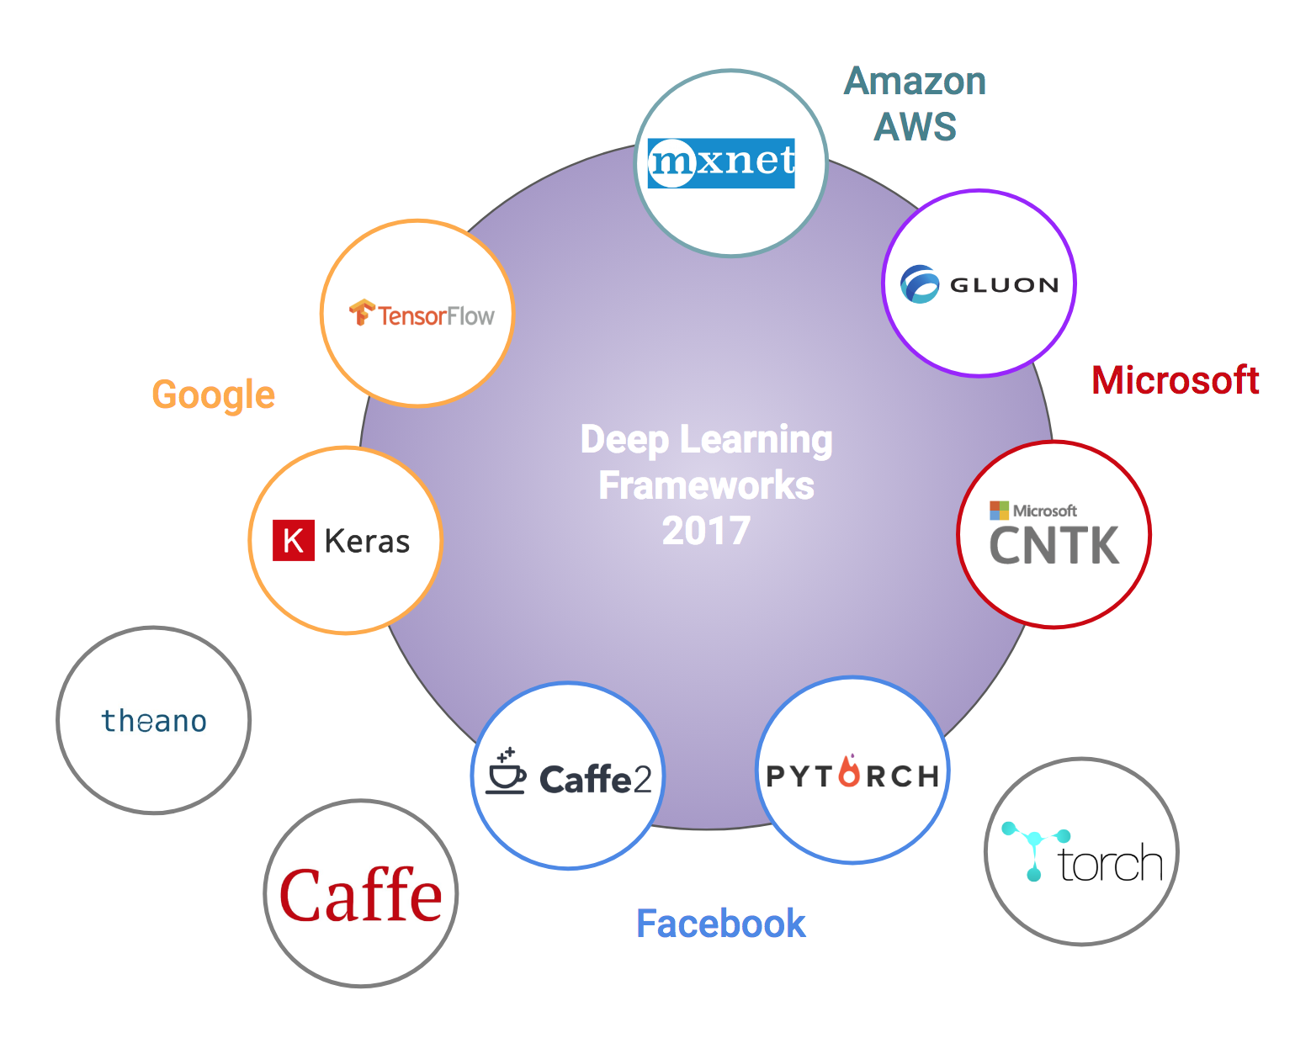

Slide 19
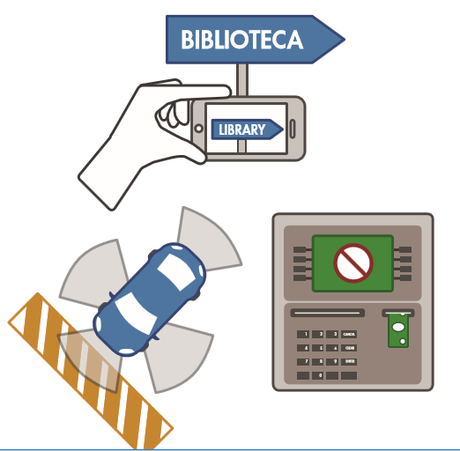
Application
A self-driving vehicle slows down as it approaches a pedestrian crosswalk.
An ATM rejects a counterfeit bank note.
A smartphone app gives an instant translation of a foreign street sign.
well-suited to identification applications such as face recognition, text translation, voice recognition, and advanced driver assistance systems, including, lane classification and traffic sign recognition.

Slide 20
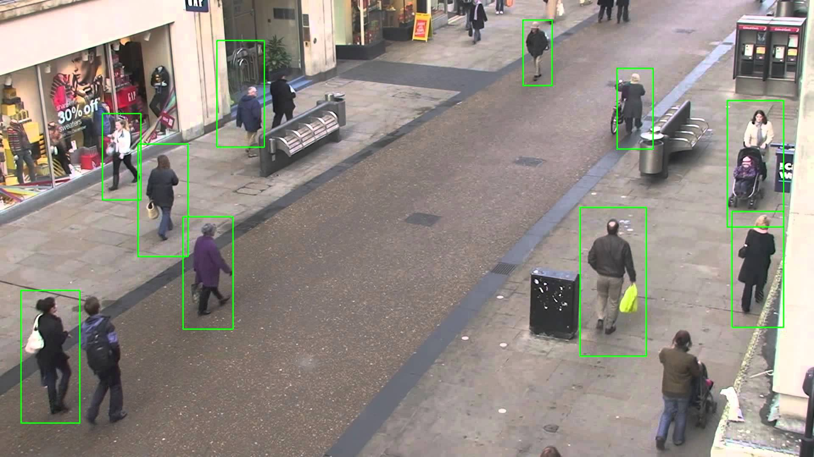
Human Detection Algorithms
Detects Humans using neural networks

Slide 21
YOLO You Look Only Once
YOLOv3 is extremely fast and accurate.
looks at the whole image at test time so its predictions are informed by global context in the image.
pre-trained weight file (237 MB)

Slide 22
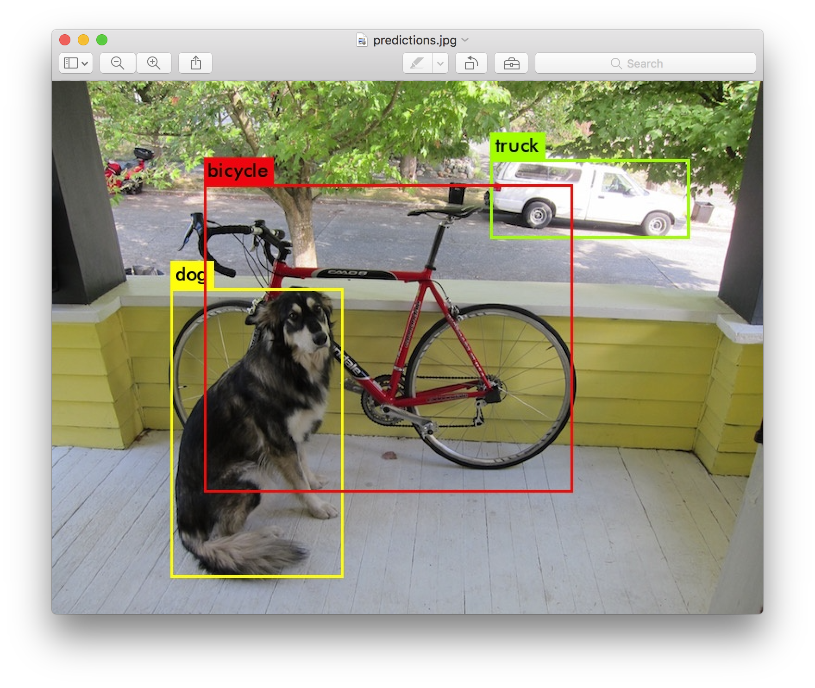

Slide 23
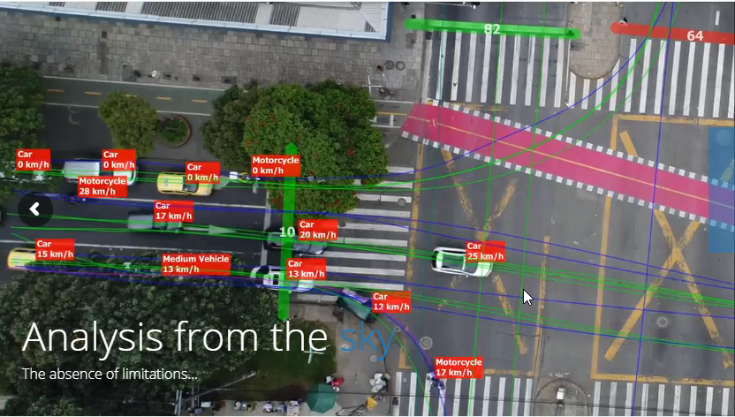
Datafromsky.com
Notes:
Although there are theories in internet that flow time to time in internet.
*******************//////////After 8Pages sentence read
Including the introductions and conclusion
It contains 10 features

Slide 24
Thank You

